Slide 1
CLICKBAIT
As Adjacent to “Fake News”

Slide 2
‘Clickbait’ refers to content whose main purpose is to attract attention and encourage visitors to click on a link to a particular web page.
(qtd. in Chen, Conroy and Rubin, 2015)
Notes:
Sensationalist and often false content (Buzzfeed)

Slide 3
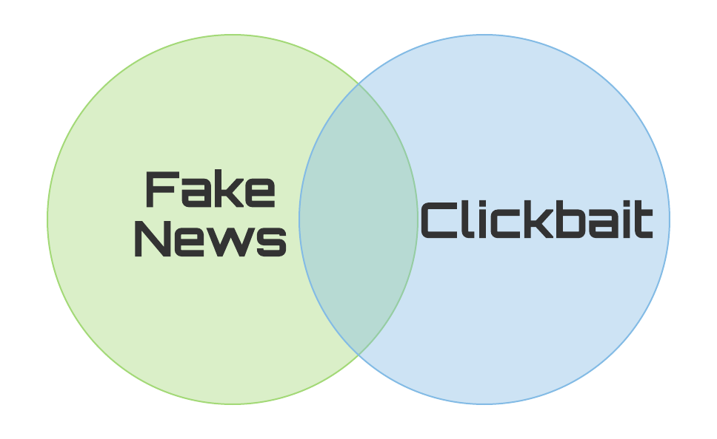
Notes:
Intentionally and verifiably false != sensationalizing content for clicks
Commonality
Method of spreading

Slide 4
GeoEngineering: China to Make it Rain over Area 3x the Size of Spain
InfoWars

Slide 5
Chris Hedges: “U.S. Citizens are Living in an Inverted Totalitarian Country”
InfoWars

Slide 6
How Twitter Pornified Politics
New York Times

Slide 7
What if Clinton Had Done All This?
New York Times

Slide 8
Lock Her Up: Hillary’s South Korean Clone Goes to Jail
InfoWars

Slide 9
A Modest Immigration Proposal: Ban Jews
New York Times

Slide 10
Is the News Media an Existential Threat?
New York Times

Slide 11
If You’re Not A Police Officer, You Can’t Understand The Pressure You Feel In The Split Second When You Have To Decide Whether Or Not To Shoot An Unarmed Civilian 8 Times
The Onion

Slide 12
1.
Where does clickbait originate from?

Slide 13

Macedonia?
Notes:
motive is money and less often politics

Slide 14
The New York Times offices?

Slide 15
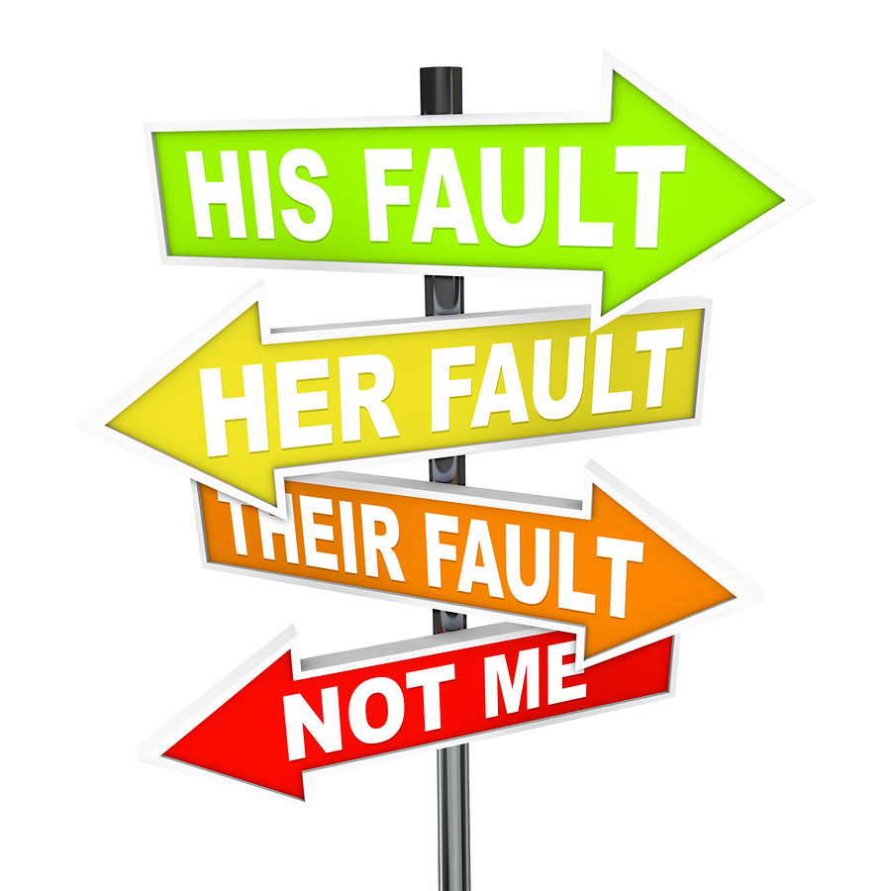
We’re at fault too
Notes:
circulation and subscriptions continue to fall and news producers depend more and more on online advertising revenue based on page views [Barthel, 2015]. Thus, the current state of online news is one that heavily incentivizes the speed and spectacle over restraint and verification in the pursuit of ad dollars [Chen, Rubin, & Conroy, 2015].
Like the academic misconduct debate

Slide 16
2.
Clickbait Detection

Slide 17
The characteristics of curiosity: its intensity, transience, association with impulsivity, and tendency to disappoint [Loewenstein, 1994] lead to cognitively induced deprivation - a knowledge gap - which motivates exploring activity from the reader. Since clickbait headlines create and exploit these knowledge gaps to entice readers to click through to see the full article, it stands to reason that these curiosity-piquing factors could serve as cues for an automated system to detect and flag this type of low-quality news. (Chen, Conroy and Rubin, 2015)

Slide 18
Levels of Text-Based Clickbait Detection
Individual Words
Sentence Structure
Subject Matter
Notes:
Hybrid

Slide 19
Clickbait tactics and detection methods
01
Unresolved pronouns
Affective and Suspenseful language
Action words
Overuse of numerals
Support Vector Machines (SVM)
Naive Bayes
Frequency analysis
02
Forward Reference
Reverse Narrative
Probability Context Free Grammars
Neural Network Analysis
03
Image Placement
Image’s emotional content
Image detection
Image caption analysis
04
Reading time
Sharing behavior
Commenting behavior
Web traffic analysis
Web metadata analysis
Sentiment analysis
Notes:
Time spent reading article suggests that an article is less likely to be clickbait

Slide 20
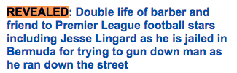
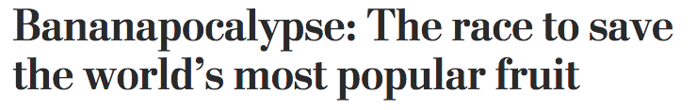
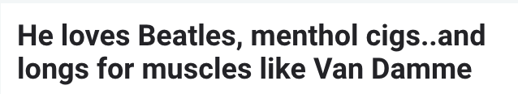
And then she drew her last breath..Sylvia Plath’s Feminism

Slide 21
3.
What Can I Do Today?

Slide 22
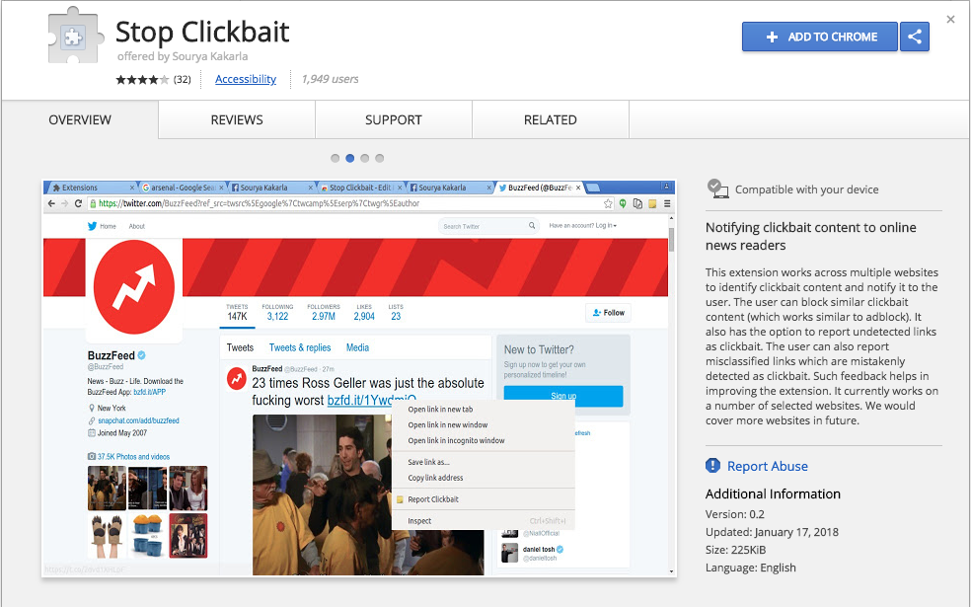
Notes:
93% accuracy in detecting and 89% accuracy in blocking clickbaits.

Slide 23
93% accuracy in detecting and 89% accuracy in blocking clickbaits.
Length of headlines
Length of words
Length of syntactic dependencies
Stop words, hyperbolic words, Internet slangs, Punctuation patterns, Determiners, Possessive case
Common bait phrases (Will Blow Your Mind”, “You Won’t Believe”)

Slide 24
Further Reading
Agrawal, A. (2018). Clickbait Detection using Deep Learning. In 2016 2nd International Conference on Next Generation Computing Technologies (NGCT-2016). Dehradun, India.
Bourgonje, P., Moreno Schneider, J., & Rehm, G. (2017). From Clickbait to Fake News Detection:An Approach based on Detecting the Stance of Headlines to Articles. In Proceedings of the 2017 EMNLP Workshop on Natural Language Processing meets Journalism (pp. 84-89). Copehagen, Denmark: 2017 Association for Computational Linguistics.
Potthast, M., & Kopsel, S. (2016). Clickbait Detection. In CIR 2016, (pp. 810-817). Springer International Publishing Switzerland.
Rubin, V., Chen, Y., & Conroy, N. (2018). Deception Detection for News: Three Types of Fakes. In ASIS&T2015. St. Louis, MO.
Rubin, V., Conroy, N., & Chen, Y. (2015). Towards News Verification: Deception Detection Methods for News Discourse. In Proceedings of the Hawaii International Conference on System Sciences (HICSS48) Symposium on Rapid Screening Technologies, Deception Detection and Credibility Assessment Symposium. Kauai, Hawaii: Western University.
Ruchansky, N., Seo, S., & Liu, Y. (2017). CSI: A Hybrid Deep Model for Fake News Detection. In 2017 ACM.

Slide 25
References
Allcott, H., & Gentzkow, M. (2017). Social Media and Fake News in the 2016 Election. Journal Of Economic Perspectives, 31(2), 211-236. http://dx.doi.org/10.1257/jep.31.2.211
Chakraborty, A., Paranjape, B., Kakarla, S., & Ganguly, N. (2016). Stop Clickbait: Detecting and Preventing Clickbaits in Online News Media. In 2016 IEEE/ACM International Conference on Advances in Social Networks Analysis and Mining (ASONAM). SanFrancisco,CA,USA.
Chen, Y., Conroy, N., & Rubin, V. (2015). Misleading Online Content: Recognizing Clickbait as "False News". In WMDD '15 Proceedings of the 2015 ACM on Workshop on Multimodal Deception Detection (pp. 15-19). Seattle, WA: ACM. Retrieved from https://dl.acm.org/citation.cfm?id=2823467
Rubin, V., Conroy, N., & Chen, Y. (2015). Towards News Verification: Deception Detection Methods for News Discourse. In Proceedings of the Hawaii International Conference on System Sciences (HICSS48) Symposium on Rapid Screening Technologies, Deception Detection and Credibility Assessment Symposium. Kauai, Hawaii: Western University.
Silverman, C., & Alexander, L. (2016). How Teens In The Balkans Are Duping Trump Supporters With Fake News. BuzzFeed. Retrieved 9 April 2018, from https://www.buzzfeed.com/craigsilverman/how-macedonia-became-a-global-hub-for-pro-trump-misinfo?utm_term=.oxwJJoAjl#.gvZQQv1EA
This template is free to use under Creative Commons Attribution license through SlidesCarnival

Slide 26
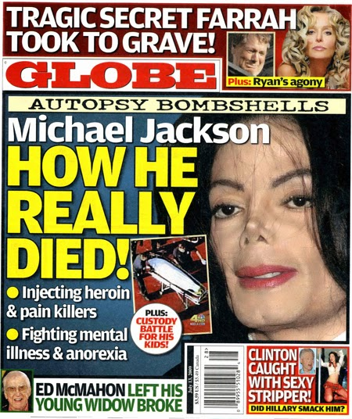

Is tabloidization or clickbaiting inherently negative?
Where is the line between clickbaiting and piquing reader curiosity?

